Slide 1
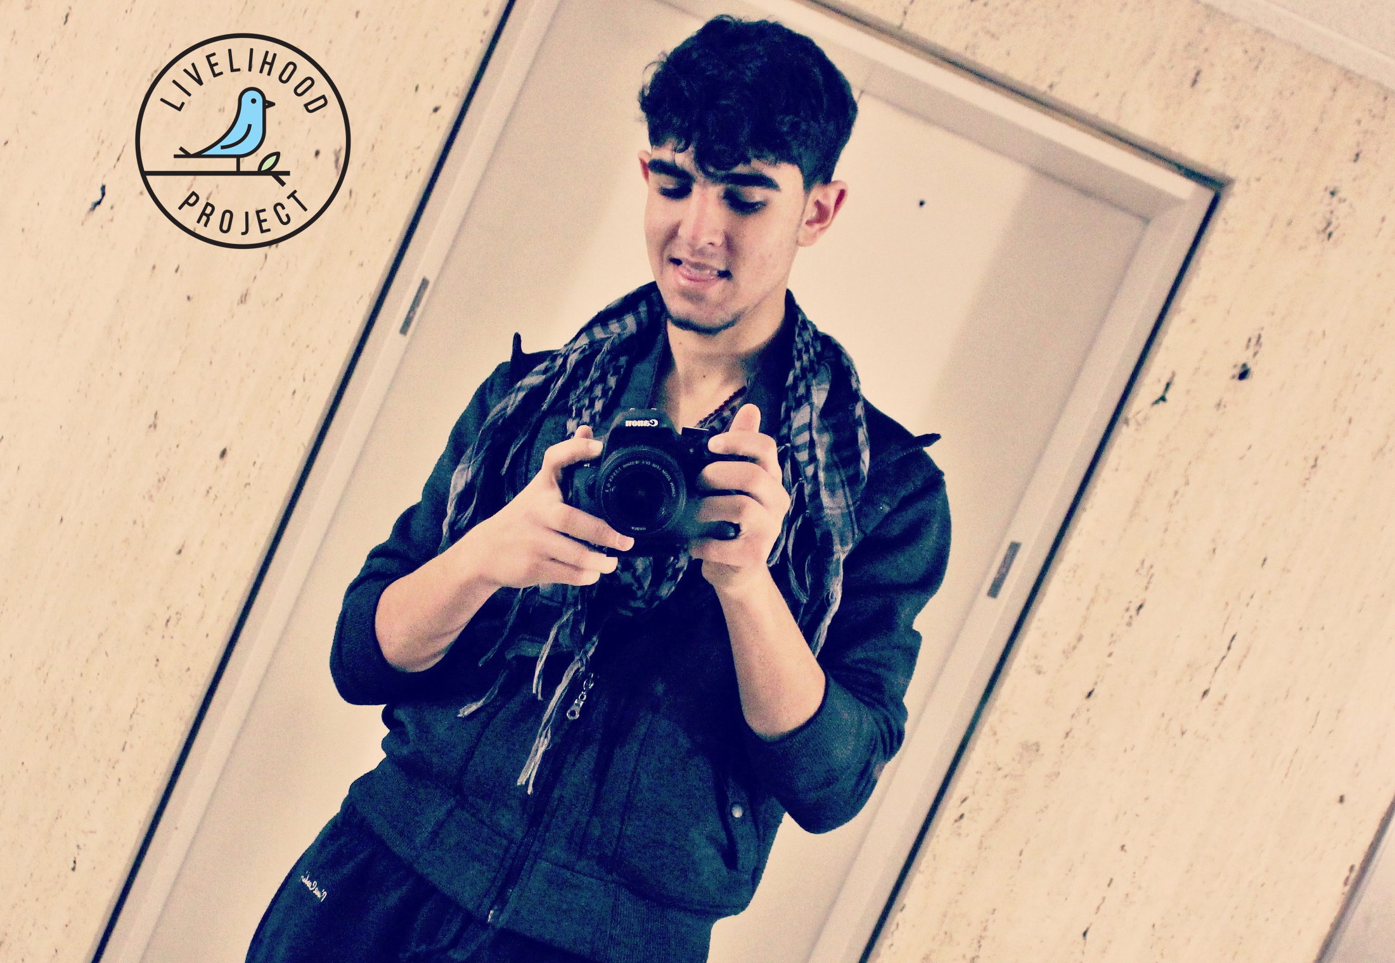
achieve your ambitions

Slide 2
our story
our programs
our people
our technology
our space
our research
our ambitions
how can i help
contact us
achieve your ambitions

Slide 3
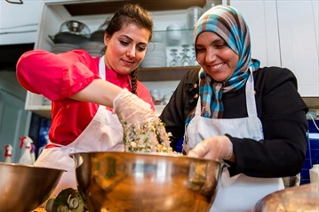

VISION
Our vision is a world where everyone has an opportunity to work as per both their abilities and aspirations, in order to make a sustainable livelihood while contributing to the overall society.
MISSION
Our mission is to help those facing barriers to suitable and sustainable employment to build a resilient career path.
get to know “us” and “our work”

Slide 4
